Slide 1
ENEL 441
Control Systems I
Arne Dankers
10-01-2023

Slide 2
Review
Complex numbers
Linear Algebra
Differential Equations
today
next week

Slide 3
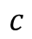
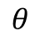

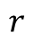
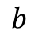
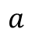
Complex numbers
Show up in Laplace Domain, Frequency (Fourier) Domain
Two common ways to represent a complex number:
In terms of real and imaginary components: $a+jb$
In terms of magnitude and phase: $re^{jθ}$
Complex plane
imaginary
$$c$$
$$b$$
$$r$$
$$θ$$
real
$$a$$

Slide 4
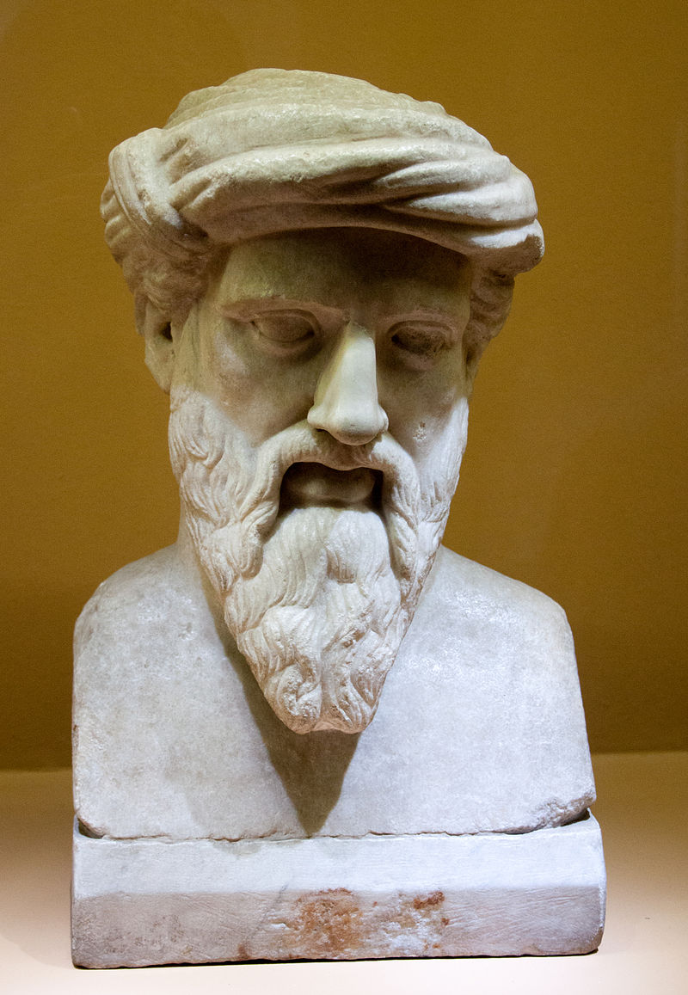
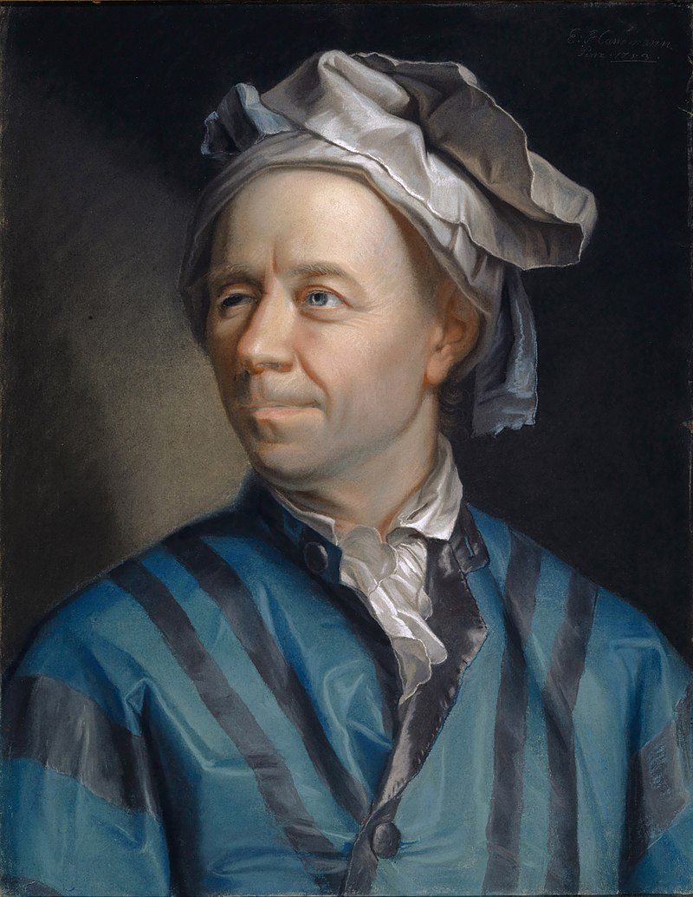

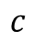
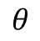
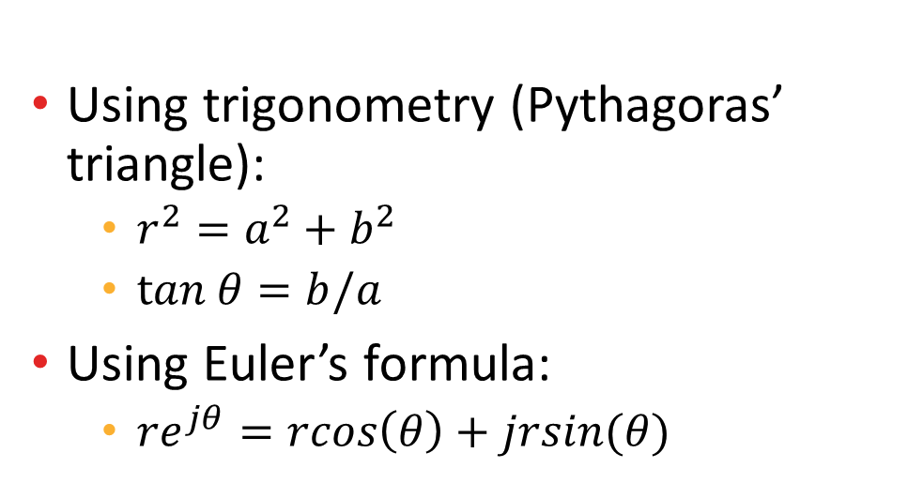
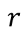
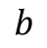
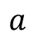
Complex Numbers
Using trigonometry (Pythagoras’ triangle):
$r^{2}=a^{2}+b^{2}$
$tan θ=b/a$
Using Euler’s formula:
$re^{jθ}=rcos\left(θ\right)+jrsin(θ)$
Complex plane
imaginary
$$c$$
$$b$$
$$r$$
$$θ$$
real
$$a$$
That’s remarkable!
Source of images: wikipedia

Slide 5
Example Problems

Slide 6
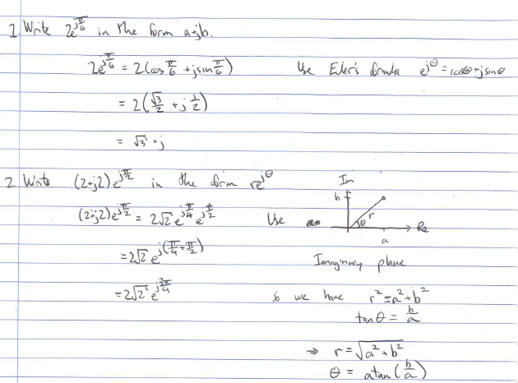
Answers to Practice Problems

Slide 7
Linear Algebra
Key concepts to remember:
Matrix multiplication
Matrix inversion
Eigenvalues

Slide 8
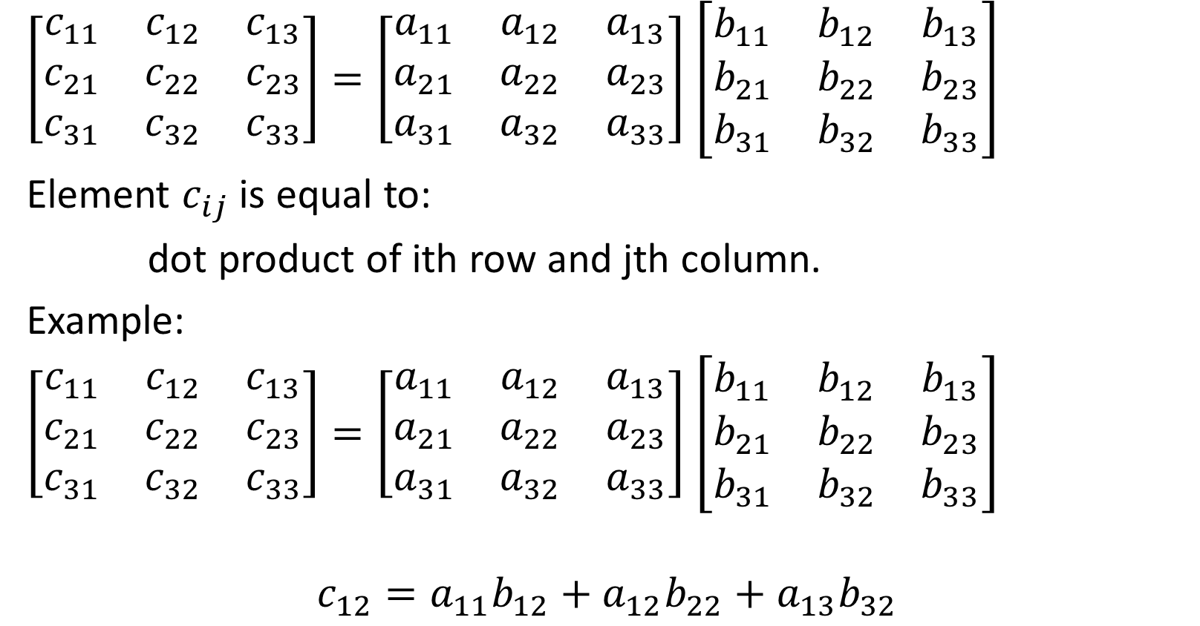
Matrix Multiplication
$\left[\begin{matrix}c_{11} & c_{12} & c_{13} \\ c_{21} & c_{22} & c_{23} \\ c_{31} & c_{32} & c_{33}\end{matrix}\right]=\left[\begin{matrix}a_{11} & a_{12} & a_{13} \\ a_{21} & a_{22} & a_{23} \\ a_{31} & a_{32} & a_{33}\end{matrix}\right]$ $\left[\begin{matrix}b_{11} & b_{12} & b_{13} \\ b_{21} & b_{22} & b_{23} \\ b_{31} & b_{32} & b_{33}\end{matrix}\right]$
Element $c_{ij}$ is equal to:
dot product of ith row and jth column.
Example:
$\left[\begin{matrix}c_{11} & c_{12} & c_{13} \\ c_{21} & c_{22} & c_{23} \\ c_{31} & c_{32} & c_{33}\end{matrix}\right]=\left[\begin{matrix}a_{11} & a_{12} & a_{13} \\ a_{21} & a_{22} & a_{23} \\ a_{31} & a_{32} & a_{33}\end{matrix}\right]$ $\left[\begin{matrix}b_{11} & b_{12} & b_{13} \\ b_{21} & b_{22} & b_{23} \\ b_{31} & b_{32} & b_{33}\end{matrix}\right]$
$$c_{12}=a_{11}b_{12}+a_{12}b_{22}+a_{13}b_{32}$$

Slide 9
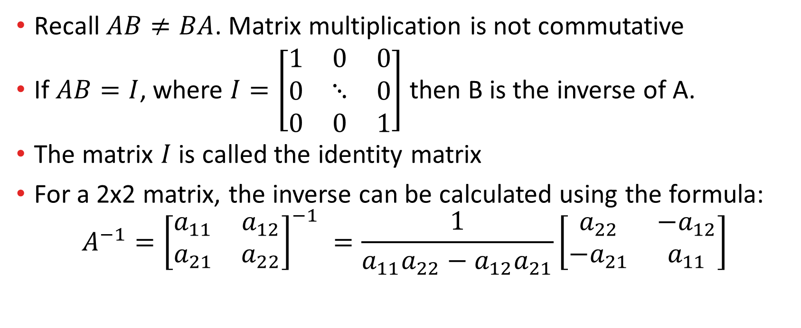
Matrix Multiplication and Matrix Inverse
Recall $AB≠BA$. Matrix multiplication is not commutative
If $AB=I$, where $I=\left[\begin{matrix}1 & 0 & 0 \\ 0 & ⋱ & 0 \\ 0 & 0 & 1\end{matrix}\right]$ then B is the inverse of A.
The matrix $I$ is called the identity matrix
For a 2x2 matrix, the inverse can be calculated using the formula:
$$A^{−1}={\left[\begin{matrix}a_{11} & a_{12} \\ a_{21} & a_{22}\end{matrix}\right]}^{−1} =\frac{1}{a_{11}a_{22}−a_{12}a_{21}}\left[\begin{matrix}a_{22} & −a_{12} \\ −a_{21} & a_{11}\end{matrix}\right]$$

Slide 10
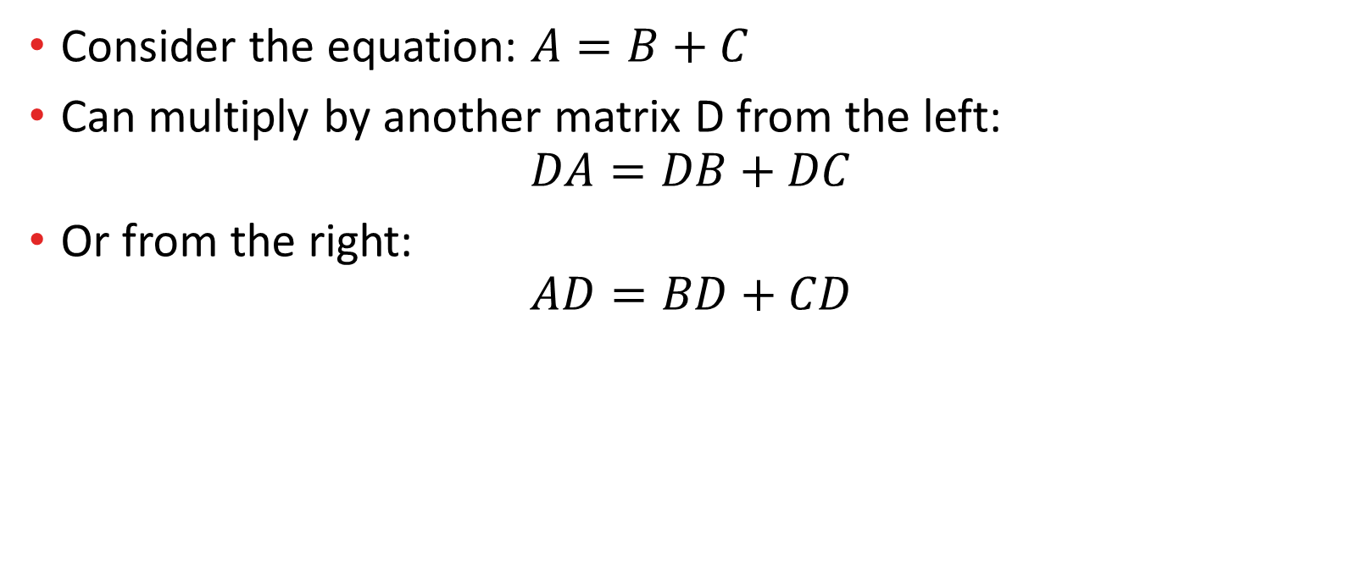
Matrix Equations
Consider the equation: $A=B+C$
Can multiply by another matrix D from the left:
$$DA=DB+DC$$
Or from the right:
$$AD=BD+CD$$

Slide 11
Practice Problems

Slide 12
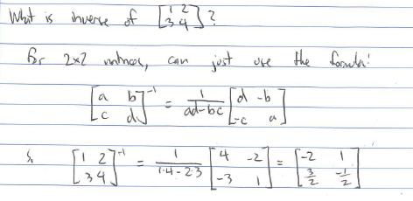
Answers to Practice Problems

Slide 13
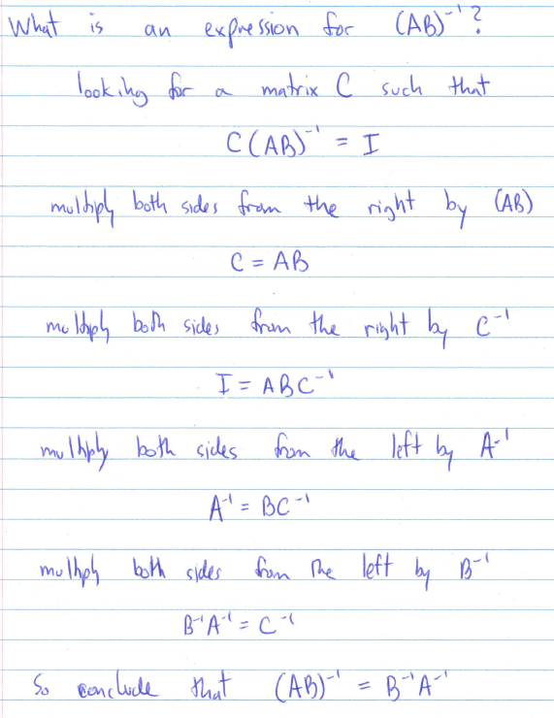
Answers to Practice Problems

Slide 14
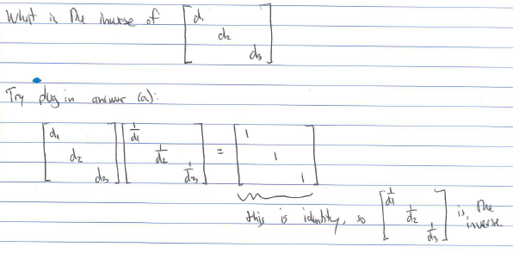
Answers to Practice Problems

Slide 15
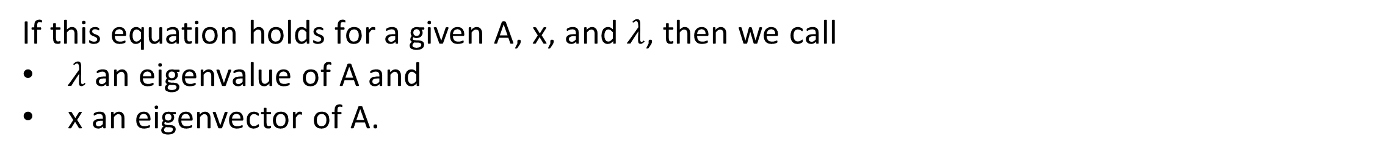

Eigenvalues
An interesting equation: A is a matrix, x is a vector, $λ$ is a scalar:
$$Ax=λx$$
This is a vector
This is a vector
If this equation holds for a given A, x, and $λ$, then we call
$λ$ an eigenvalue of A and
x an eigenvector of A.

Slide 16
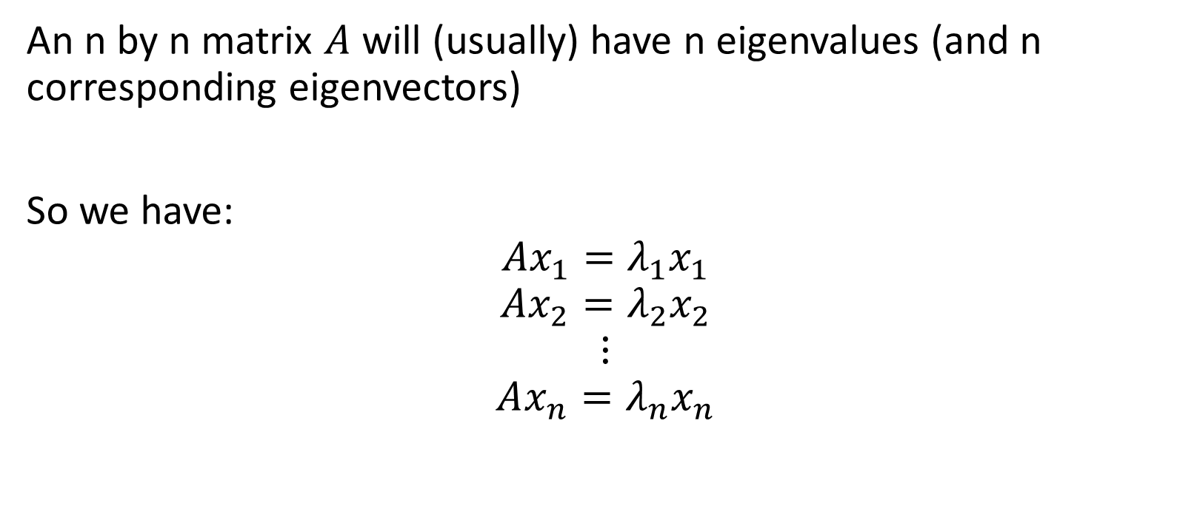
Eigenvalues
An n by n matrix $A$ will (usually) have n eigenvalues (and n corresponding eigenvectors)
So we have:
$$Ax_{1}=λ_{1}x_{1}$$
$$Ax_{2}=λ_{2}x_{2}$$
$$⋮$$
$$Ax_{n}=λ_{n}x_{n}$$

Slide 17

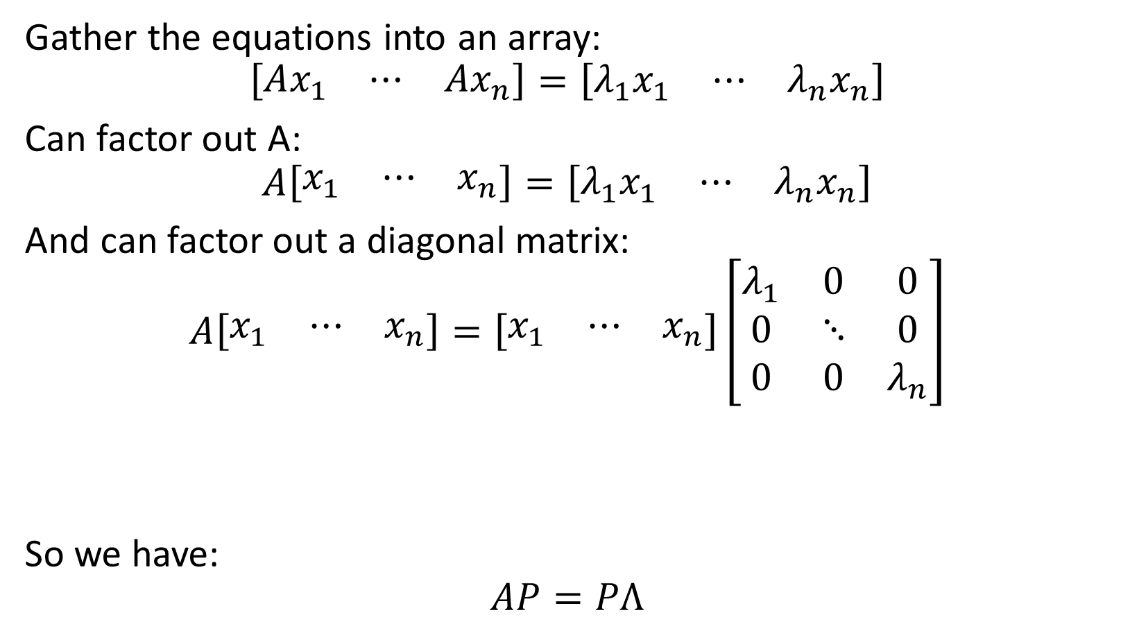
Eigenvalues
Gather the equations into an array:
$$\left[\begin{matrix}Ax_{1} & ⋯ & Ax_{n}\end{matrix}\right]=\left[\begin{matrix}λ_{1}x_{1} & ⋯ & λ_{n}x_{n}\end{matrix}\right]$$
Can factor out A:
$$A\left[\begin{matrix}x_{1} & ⋯ & x_{n}\end{matrix}\right]=\left[\begin{matrix}λ_{1}x_{1} & ⋯ & λ_{n}x_{n}\end{matrix}\right]$$
And can factor out a diagonal matrix:
$$A\left[\begin{matrix}x_{1} & ⋯ & x_{n}\end{matrix}\right]=\left[\begin{matrix}x_{1} & ⋯ & x_{n}\end{matrix}\right]\left[\begin{matrix}λ_{1} & 0 & 0 \\ 0 & ⋱ & 0 \\ 0 & 0 & λ_{n}\end{matrix}\right]$$
So we have:
$$AP=PΛ$$
Verify this step!
Call this matrix P
Call this matrix $Λ$

Slide 18
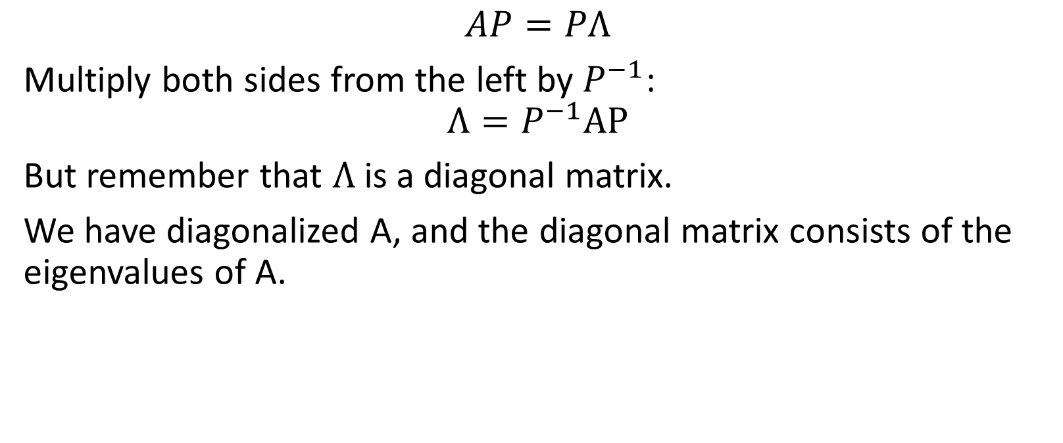
Eigenvalues and Matrix Diagonalization
$$AP=PΛ$$
Multiply both sides from the left by $P^{−1}$:
$$Λ=P^{−1}AP$$
But remember that $Λ$ is a diagonal matrix.
We have diagonalized A, and the diagonal matrix consists of the eigenvalues of A.

Slide 19
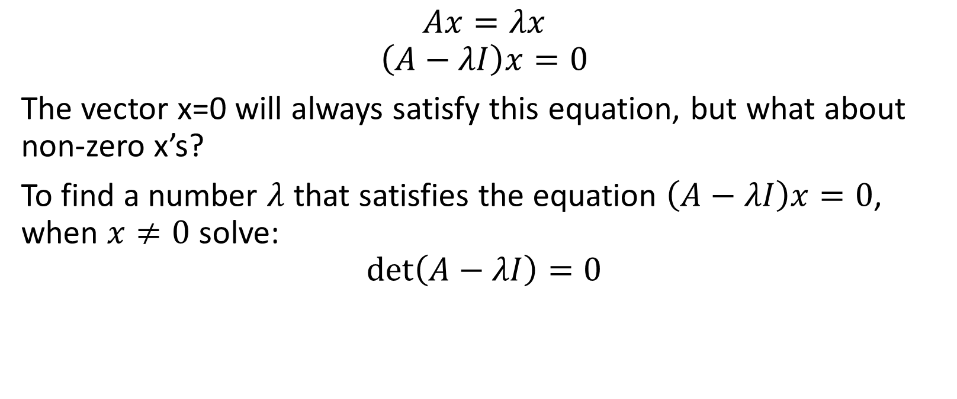
Calculating Eigenvalues
$$Ax=λx$$
$$\left(A−λI\right)x=0$$
The vector x=0 will always satisfy this equation, but what about non-zero x’s?
To find a number $λ$ that satisfies the equation $\left(A−λI\right)x=0$, when $x≠0$ solve:
$$\det\left(A−λI\right)=0$$

Slide 20
Practice Problems

Slide 21
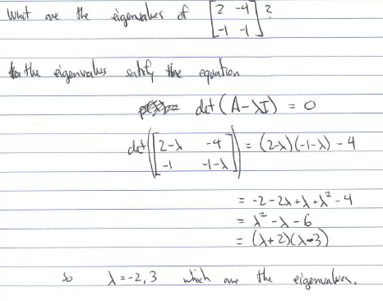
Answers to Practice Problems

